Slide 1
Sentiment Analysis

Slide 2
Introduction to Sentiment Analysis
What is Sentiment Analysis?
Why is it important?
Where can it be used?
Sentiment Analysis is a process of analyzing and determining the emotional tone expressed in text.
Build better products and services
Analyze at Scale
Real time results

Slide 3
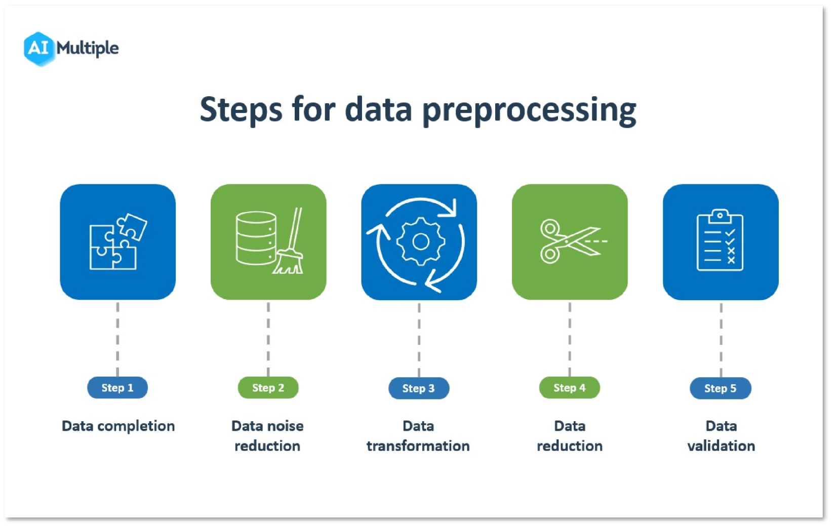
Data Preprocessing

Slide 4
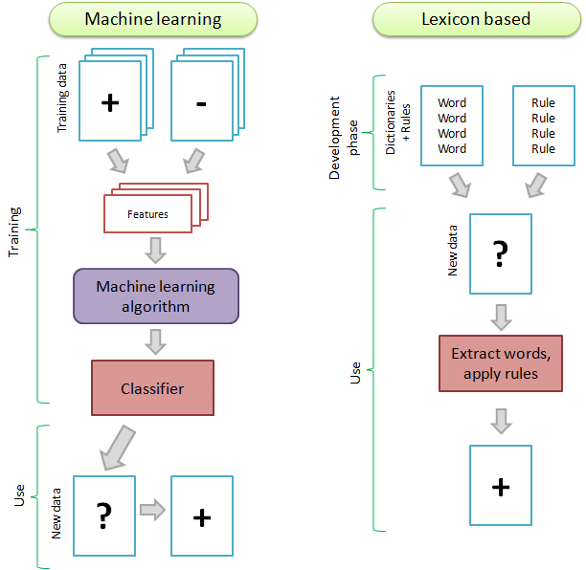
Sentiment Analysis Approaches

Slide 5
3 Approaches:
Rule-based:
The rule-based approach to sentiment analysis uses predefined lexicons containing words associated with various emotions. By assigning sentiment scores to these words, the software scans text calculates a cumulative score, and then compares it against predefined boundaries to determine whether the sentiment in the text is positive, negative, or neutral.
Pros of Rule-Based Sentiment Analysis:
Easy to set up and implement.
Transparent and interpretable results.
Suitable for smaller projects and quick sentiment analysis tasks.
Cons of Rule-Based Sentiment Analysis:
Difficult to scale and maintain, as lexicons need constant updates for new keywords.
May not be accurate when analyzing text influenced by diverse cultures and languages.
Limited in handling nuanced or complex sentiments.

Slide 6
VADER(Valence Aware Dictionary and sEntiment Reasoner)
VADER is tailored for analyzing sentiment in social media text, where sentiment expression is unique.
It determines sentiment by referencing a lexicon with words rated on a scale of -4 to 4. The lexicon was built by having individuals rate thousands of words, and you can explore it on GitHub(https://github.com/cjhutto/vaderSentiment).
Each entry in the lexicon includes a word, its mean rating, standard deviation, and individual human ratings.
Also, in addition to lexicon VADER calculates the scores by using 5 simple rules.
If there’s punctuation, especially exclamation points, the sentiment intensity should be increased (e.g., “Mochi ice cream is bliss” 👍 vs “Mochi ice cream is bliss!!!” 👍👍👍 )
If there’s capitalization, especially all caps, the sentiment intensity should be increased (e.g., “Mochi ice cream is bliss” 👍 vs “Mochi ice cream is BLISS” 👍👍👍 )
If there are words like “extremely” or “absolutely”, the sentiment should be increased (“Mochi ice cream is good” 👍 vs “Mochi ice cream is extremely good” 👍👍👍 )
If there’s a “but” in a sentence, the polarity of the sentiment should shift, and the sentiment that follows the “but” should be prioritized (e.g., “Mochi ice cream is nice” 👍 vs “Mochi ice cream is nice, but it’s a little blah” 👎 )
If there’s a negation before an important word, the sentiment polarity should be flipped (“Mochi ice cream is my favorite” 👍 vs “Mochi ice cream is not my favorite” 👎 )

Slide 7
Drawback: norm_score = score/math.sqrt((score*score) + alpha)
'I like the Marvel movies’
🙁 Negative Sentiment: 0.0
😐 Neutral Sentiment: 0.361
😀 Positive Sentiment: 0.639
✨ Compound Sentiment: 0.6486
---
'I don't like the Marvel movies'
🙁 Negative Sentiment: 0.526
😐 Neutral Sentiment: 0.474
😀 Positive Sentiment: 0.0
✨ Compound Sentiment: -0.5334
'I despise the Marvel movies with every fiber of my being'
🙁 Negative Sentiment: 0.169
😐 Neutral Sentiment: 0.634
😀 Positive Sentiment: 0.197
✨ Compound Sentiment: 0.1027
---
'I don't *not* live the Marvel movies'
🙁 Negative Sentiment: 0.28
😐 Neutral Sentiment: 0.72
😀 Positive Sentiment: 0.0
✨ Compound Sentiment: -0.3252

Slide 8
Machine Learning Based:
The Machine Learning (ML) approach for sentiment analysis utilizes algorithms like neural networks and deep learning to enable software to recognize emotional sentiment in text. This involves creating a sentiment analysis model and training it on extensive datasets.
Pros of ML Sentiment Analysis:
Accurately processes a wide range of text data.
High accuracy when trained with sufficient examples.
Cons of ML Sentiment Analysis:
Model specificity: Requires retraining for different business areas, e.g., marketing data vs. social media monitoring.
Hybrid Based:
Hybrid sentiment analysis combines the strengths of both ML and rule-based approaches to enhance accuracy and speed in understanding the contextual intent of text. It optimizes performance by leveraging features from both methods.
However, integrating these two distinct systems requires a significant investment of time and technical resources.

Slide 9
Random Forest
A widely used supervised machine learning algorithm approach handles both classification and regression problems.
It combines the output of multiple decision trees to reach a single result. The greater the number of trees in a random forest algorithm, the higher its accuracy and problem solving ability.
It uses a Ensemble learning technique, where predictions are made using collection of models rather than individual model.
Advantages of Random Forest :
It is highly stable and performs well even if the data contains null values.
Solves the problem of overfitting
Performs better for classification and regression tasks
Disadvantages of Random Forest:
It is highly complex than decision tree, where decisions can be made by following the path of the tree.
Training time is more than other models due to its complexity.
The exact data might not be identified due to some missing patterns.

Slide 10
Key takeaways:
In summary, VADER is a rule-based tool designed for short texts with a specific focus on social media data.
Random Forest is a machine learning approach that requires training on labeled data and can capture complex patterns.
Lexicon-based sentiment analysis relies on predetermined lexicons and is relatively straightforward to implement.
These approaches vary in their complexity, applicability, and requirements. The choice of approach depends on the specific use case, the nature of the text data, and the resources available for sentiment analysis. VADER is suitable for social media, Random Forest excels with substantial labeled data, and lexicon-based methods are straightforward but may lack nuance.

Slide 11
References:
https://aws.amazon.com
https://ojs.aaai.org/index.php/icwsm/article/view/14550
VADER: A Parsimonious Rule-based Model for Sentiment Analysis of Social Media Text
https://www.geeksforgeeks.org/python-sentiment-analysis-using-vader/
https://melaniewalsh.github.io/Intro-Cultural-Analytics/05-Text-Analysis/04-Sentiment-Analysis.html#how-vader-was-built-and-how-it-works
https://github.com/cjhutto/vaderSentiment
https://ptrckprry.com/course/ssd/data/positive-words.txt
https://ptrckprry.com/course/ssd/data/negative-words.txt
https://www.analyticsvidhya.com/blog/2021/12/different-methods-for-calculating-sentiment-score-of-text/
https://scikit-learn.org/stable/modules/feature_extraction.html#text-feature-extraction
https://www.researchgate.net/profile/Tapasy-Rabeya/publication/369479012_A_Rule-Based_Approach_for_Sentiment_Analysis_of_Products_Review/links/641d3497315dfb4ccea54574/A-Rule-Based-Approach-for-Sentiment-Analysis-of-Products-Review.pdf

Slide 12
Thank You

